Slide 1
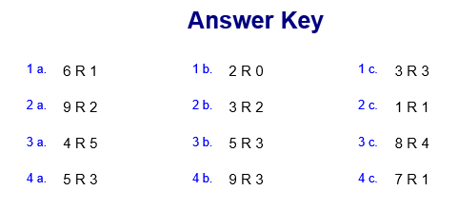
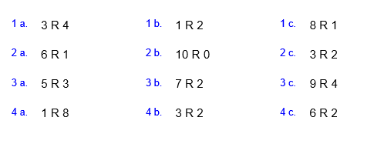
EASY division

Slide 2
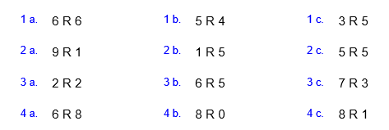
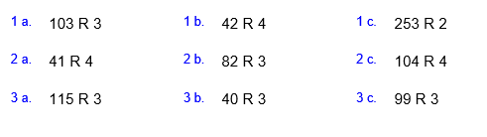
Hard division

Slide 3
Level Descriptors: KS3 Programming
Level 3 Create a linear program incorporating basic user inputs and outputs Declare and assign information to variables Concatenate strings with information assigned to variables
Level 4 Identify the need to store information with different data types Use IF and ELSE statements to make decisions Use WHILE and FOR loops for iterative processes Use the: ‘equal to’, ‘not equal to’, ‘greater than’ and ‘less than’ comparison operators
Level 5 Use subroutines to create efficient programs and reduce duplication of code Use 1-dimentional arrays to store and retrieve information Use bitwise operators: ‘AND’ & ‘OR’ as part of conditions to be evaluated
Level 6 Use of functions which take arguments and return values to create efficient programs Use of 2-dimentional arrays to store and retrieve information https://www.youtube.com/watch?v=dU1xS07N-FA

Slide 4

Introduction to Small Basic
In this lesson, you will learn how to:
Identify a variable.
Understand what concatenate means.
Understand the difference between sequence and selection.
Use IntelliSense® technology.
Save your program.

Slide 5
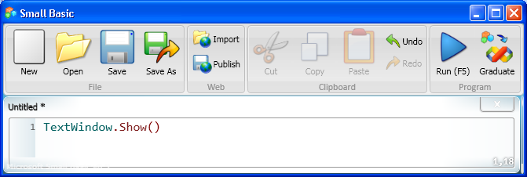
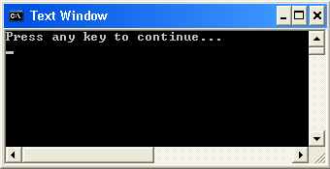

Showing and Hiding the Text Window
The text window is an object, and you can instruct the computer to perform operations on that object. For example, you can display the TextWindow object by using the Show operation.
output
Click the button on the Toolbar.
Similarly, you can hide the TextWindow object by using the Hide operation.
Notes:
Let’s see how you can show or hide the text window.
First, type TextWindow.Show() in the Editor, and then click Run on the Toolbar. The result of your program is that the text window appears.
Similarly, you can hide the text window if you type the statement TextWindow.Hide() in the Editor and then click Run on the Toolbar.

Slide 6
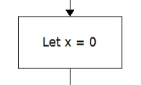
What is a variable?
A variable is a __________ for a _______ that can ________
In this example the variable name is _______ and it is set to the value of ______
Task 1: Fill in the gaps.
HINT: CHANGE , STORE, VALUE,

Slide 7
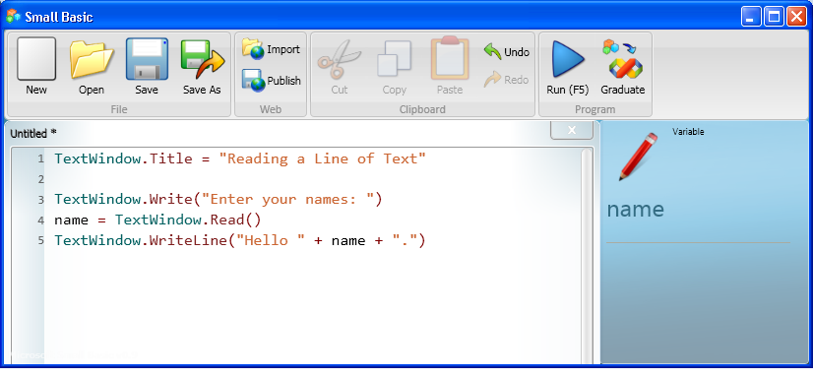
What is concatenation?
Concatenation is where we __________ 2 or more things in a _______. This allows us to place ________ in the output of a string.
Task 1: Fill in the gaps.
HINT: JOIN , VARIABLES, STRING,

Slide 8
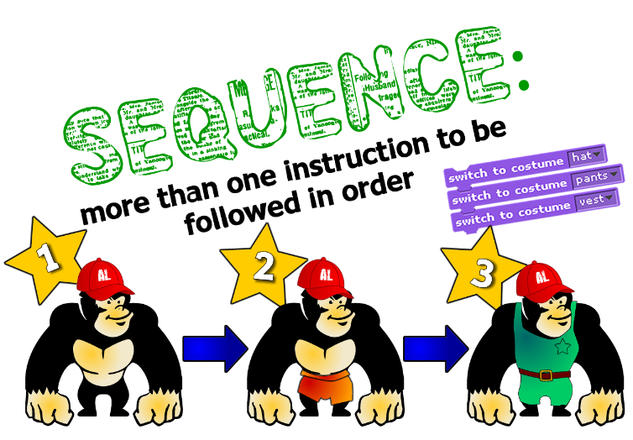

Slide 9
What is a sequence?
A sequential program is a __________ where the _______ follow one after the other.
In this example the program has a _______ of ______ instructions
Task 1: Fill in the gaps.
HINT: INSTRUCTIONS , PROGRAM, SEQUENCE, 3

Slide 10
What does this command do?
TASK 1: Write the following in Small Basic
Does this program use sequence or selection?
What is the name of the variable in this program?
What does the + do in the last line of the program?

Slide 11
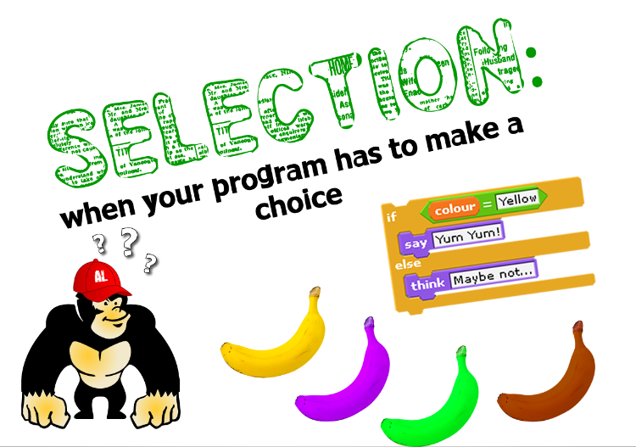

Slide 12
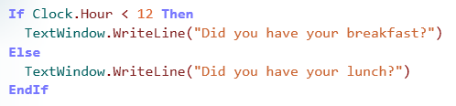
What is a selection?
A selection in a ______ is where there is a _______ dependent on a _______ being met .
In this example the program has a choice _______ on whether the time is before or after ____ o’clock.
Task 1: Fill in the gaps.
HINT: CHOICE , PROGRAM, CONDITION, DEPENDENT, 12

Slide 13

What does this command do?
TASK 3: Write the following in Small Basic
Does this program use sequence or selection?
Can you explain what this program does?

Slide 14
What does this command do?
TASK 2: Write the following in Small Basic
Does this program use sequence or selection?
Can you explain what this program does?

Slide 15
Long Division
To do long division we divide 1 number by the other:
9 r1
4 37
36
1

Slide 16
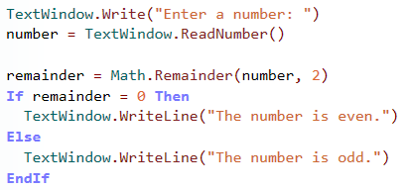
What does this command do?
TASK 3: Write the following in Small Basic
Does this program use sequence or selection?
Can you explain what this program does?

Slide 17
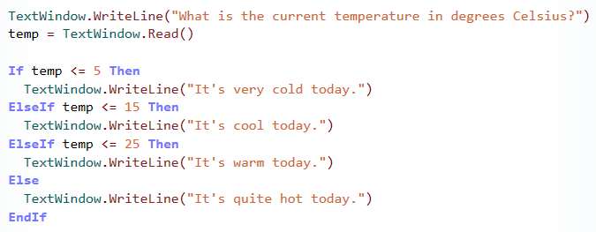
What does this command do?
TASK 4: Write the following in Small Basic
Does this program use sequence or selection?
Can you explain what this program does?

